Slide 1
Oral Hygiene Instruction & Techniques for the Caregiver
To Nurture and Respect

Slide 2
Introduction
Oral hygiene instructions (OHI), defined
Growth of aging population
1900 vs. today
Older adults now keep more of their natural teeth than previous decades
To Nurture and Respect

Slide 3
Common Dental Concerns for Seniors
Tooth aches and tooth decay
Shifting teeth
Poor Diet
Ill fitting dental appliances
“Dry mouth syndrome”
To Nurture and Respect

Slide 4
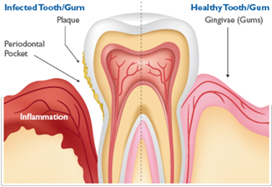
Gum Disease in Seniors
Gingivitis
Also known as gum disease or early periodontal disease
Stages of periodontal disease
Healthy gums
Gingivitis
Periodontitis
Advanced Periodontitis
Leading cause of tooth loss
To Nurture and Respect

Slide 5
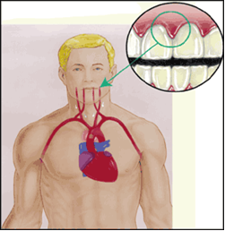
Gum Disease in Seniors
Effects of Gum Disease on Overall Health
To Nurture and Respect

Slide 6
Causes of Gum Disease
Plaque
Hormonal changes
Illness
Medications
Personal habits
Poor oral hygiene
Family history
To Nurture and Respect

Slide 7
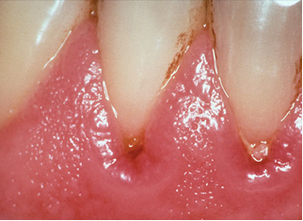
How to Recognize Gum Disease
Often a silent disease
Warning signs:
Bleeding after brushing
Red, swollen gums
Bad breath/taste in mouth
Receding gums
Pockets between teeth and gums
Loose or shifting teeth
Tooth shifting
To Nurture and Respect

Slide 8
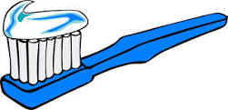
Planned Activities
Brush twice daily
Floss daily
Visit dentist regularly
Treatment combined with home maintenance
To Nurture and Respect

Slide 9
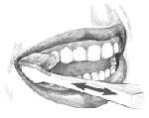
Basics of Toothbrushing
1. Tilt brush at a 45 degree angle against the gumline and sweep the brush away from the gumline.
2. Gently brush the outside, inside and chewing surface of each tooth using short back-and-forth strokes.
3. Gently brush your tongue to remove bacteria and freshen breath.
To Nurture and Respect

Slide 10
If your patient is unable to brush
Steps Involved:
Wash your hands and put on disposable gloves.
Sit or stand where you can see all of the surfaces of the teeth.
Use a regular or power toothbrush with soft bristles.
Use a pea-size amount of toothpaste with fluoride, or none at all if patient has a sensitivity to toothpaste.
Brush the front, back, and top of each tooth. Gently brush back and forth in short strokes.
Gently brush the tongue after you brush the teeth.
Help the person rinse with plain water.
Get a new toothbrush with soft bristles every 3 months, after a contagious illness, or when the bristles are worn.
To Nurture and Respect

Slide 11
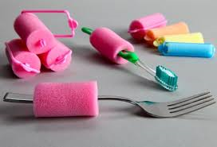
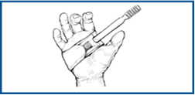
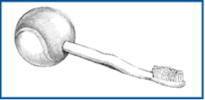
If your patient is unable to brush
Helpful tip:
Make the toothbrush easier to hold for the patient
Velcro® strap
Tennis ball, bicycle grip or foam tubing over handle
To Nurture and Respect

Slide 12
If your patient is unable to brush
Location:
Not necessarily a bathroom
Table with toothbrush, toothpaste, floss, bowl and glass of water
Well lit area
To Nurture and Respect

Slide 13
If your patient is unable to brush
Positioning:
Safety is key
Review positioning with supervisor to ensure patient safety
If patient is in a wheelchair:
Sit behind wheelchair
Lock wheels
Stand behind the person or lean against the wall for support
To Nurture and Respect

Slide 14
If your patient is unable to brush
Easing Patient Fears
Dental care can cause anxiety in some patients
Try the “tell-show-do” approach
Explain how you will help them brush and what it feels like
Show how you will do each step before you do it
Be patient
Use your voice and body language to communicate that you care
Give positive feedback
Have a set routine
Be creative to help them feel more comfortable
To Nurture and Respect

Slide 15
The Importance of Flossing
Floss Every Day!
Flossing cleans between the teeth where a toothbrush can't reach.
Many people with disabilities need a caregiver to help them floss.
Flossing properly takes practice.
Waxed, unwaxed, flavored, or plain floss all do the same thing.
To Nurture and Respect

Slide 16
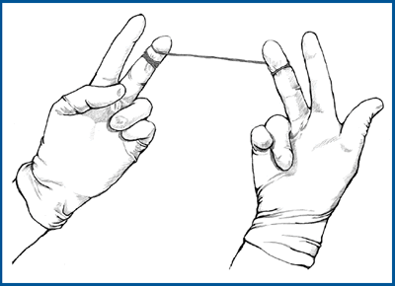
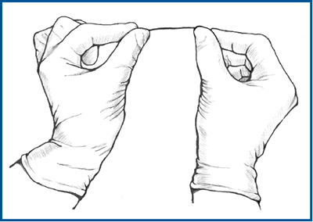
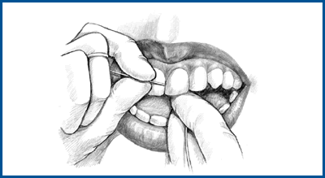
The Importance of Flossing
Flossing Procedure
Use a string of floss 18 inches long and wrap around the middle finger of each hand.
Grip the floss between the thumb and index finger of each hand.
Start with the lower front teeth, then floss the upper front teeth. Next, work your way around to all the other teeth.
Work the floss gently between the teeth until it reaches the gumline. Curve the floss around each tooth and slip it under the gum. Slide the floss up and down. Do this for both sides of every tooth, one side at a time.
Adjust the floss a little as you move from tooth to tooth so the floss is clean for each one.
To Nurture and Respect

Slide 17
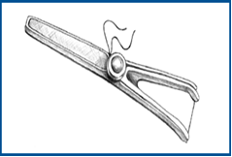
The Importance of Flossing
Tip: If you have trouble flossing, try using a store-bought floss holder instead of holding the floss with your fingers.
To Nurture and Respect

Slide 18
Thank you for listening to this presentation!
To Nurture and Respect

