Slide 1
Dental Considerations in Geriatric Practice
To Nurture and Respect

Slide 2
To hear the audio lecture, click on the speaker symbol in the corner of each slide.
To Nurture and Respect

Slide 3
Your Presenter
Dr. Dennis Yee
To Nurture and Respect

Slide 4
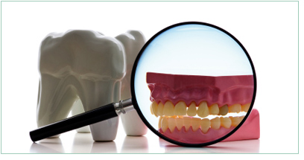
Dental Examinations
Integral component of oral health care
For new or established patients
Evaluation of oral and intraoral hard and soft tissues
To Nurture and Respect

Slide 5
Dental Examinations
Examination may include:
Review of patient’s dental/medical history and overall health assessment
Risk of tooth/root decay and gum/bone disease
Evaluation of dental caries
Evaluation of need for tooth restoration or replacement
Check for bite and jaw problems
General oral hygiene evaluation
Oral cancer screening
Demonstration of denture care procedures
Discussion of lifestyle factors affecting oral health
To Nurture and Respect

Slide 6
Dental Examinations
The Comprehensive Exam May Also Include:
Head and neck area
Soft tissue
Gum tissue
occlusion
To Nurture and Respect

Slide 7
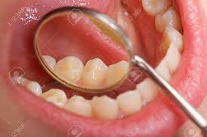
Dental Examinations
Clinical Examination of Teeth:
Assists detection of tooth decay
Explorer, defined
Check for problems with fillings, braces, bridges, dentures, crowns, etc.
To Nurture and Respect

Slide 8
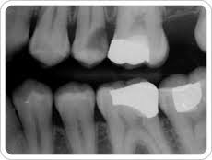
Dental X-Rays
May be part of dental exam
Detailed view of the mouth, including bone
Varieties include:
Bitewing
periapical
To Nurture and Respect

Slide 9
Dental X-Rays
Digital X-Rays
Advantages
Radiation Safety
Patient protective equipment always used
To Nurture and Respect

Slide 10
Importance of Periodic Evaluations
Protect patient well-being
Opportunity for professional health care guidance
Detect problems early
To Nurture and Respect

Slide 11
When a Dental Exam is Needed
Should be scheduled regularly
Imperative even if patient wears dentures
Communication is key
To Nurture and Respect

Slide 12
When a Dental Exam is Needed
Dental Concerns and Warning Signs:
Tooth ache
Tooth decay
Poor diet
Ill-fitting dental appliances
“dry mouth” syndrome
Red, swollen or bleeding gums
Bad breath/bad taste in mouth
Receding gums
Loose teeth
Changes in bite
To Nurture and Respect

Slide 13
When a Dental Exam is Needed
Frequency of Exam?
Varies based upon the individual.
To Nurture and Respect

Slide 14
When a Dental Exam is Needed
High Risk Patients:
Smokers (current or former)
Chewing tobacco users
Diabetics or other systemic health issues
Gum disease
Weak immune response to bacterial infections
Those with frequent cavities
Those with heavy plaque buildup
To Nurture and Respect

Slide 15
Mouth-to-Body Connection
To Nurture and Respect

Slide 16
Oral Cancer Exam
Dentist will look for signs of oral cancer during exam
May palpitate jaw, neck, lips and cheeks
May examine roof and floor of mouth and tongue
Occurrence on the rise, especially in the elderly
To Nurture and Respect

Slide 17
Oral Cancer Exam
Brush Biopsy Diagnostic Test
Non-invasive
Uses small nylon brush to gather surface cells
Sent to lab for analysis
Four steps in test
To Nurture and Respect

Slide 18
Treatment Recommendations
Dentist will determine after conducting exam
May include additional tests or restorative work
Most pre-printed progress notes contain a section for treatment recommendations
Located in bottom quarter of DENTAL NOTE page of charts for Lumina Healthcare-affiliated dentists
To Nurture and Respect

Slide 19
Treatment Recommendations
Comprehensive Dental Treatment May Include:
Examination
X-Rays
Emergency treatment
Prophylaxis
Scaling and root planning
Restorations (fillings)
Extractions
Dentures/denture repairs
Crowns and bridge work
Dental implants
Consultations
Specialist referrals
To Nurture and Respect

Slide 20
Dental Abbreviations
To Nurture and Respect

Slide 21
Dental Abbreviations

Slide 22
Pre-Authorization for Dental Treatment
Many dental procedures require pre-authorization from insurer
Denti-Cal pre-authorization procedure
Timeline = up to 8-10 weeks
To Nurture and Respect

Slide 23
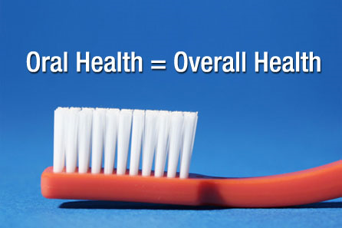
Conclusion
To Nurture and Respect

Slide 24
Thank you for listening to this presentation!
To Nurture and Respect

